Slide 1

Müllerian Duct Anomalies
Diagnostic and therapeutic aspects
هوالحکیم
Supervisor: Dr.Mehri Mashayekhi
Presented By: Dr. Nastaran Abolghasem

Slide 2
Müllerian Duct Anomalies
CONGENITAL UTERINE ANOMALIES
Uterus
cervix
fallopian tubes
Upper vagina

Slide 3
prevalence in general population 4.3–6.7%
prevalence in the infertile population 3–13%.
In patients with recurrent miscarriages, ~13.3–24.5%.
Karyotypes are normal (46XX) in majority (92%)
Abnormal in 7.7%

Slide 4
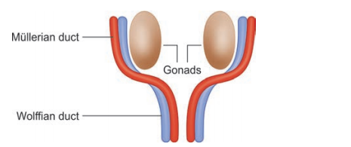
Embryology of the Female Reproductive Tract and Etiology of Müllerian Anomalies
The development of the female gonads and the Müllerian
system are separate processes.
The uterus and the fallopian tubes are developmentally derived from the paramesonephric (Müllerian) ducts
Arise lateral to the mesonephric (Wolffian) ducts from the coelomic epithelium of the urogenital ridge.
The process of development is generally completed by 20 weeks of gestation.
Since embryologically, ovaries develop from the primordial germ cells which migrate to the genital ridge

Slide 5
Embryology of the Female Reproductive Tract
Duct development
Both male and female embryos begin with undifferentiated gonads and paired genital ducts
mesonephric (Wolffian)
paramesonephric (Mullerian)
Differentiation of gonads depends on the Y chromosome.
gene on Y-chromosome, testes develop in male fetuses.
Sertoli cells in the testis produce Mullerian inhibiting hormone (MIH), which causes degeneration of Mullerian ducts
In the absence of a Y chromosome in female fetuses, the gonads differentiate into ovaries.
After 6 weeks of gestation, due to the absence of MIH and under the influence of maternal and placental estrogens, Mullerian ducts develop and Wolffian ducts degenerate.
Interruption at this stage results in developmental anomalies such as agenesis or hypoplasia of the uterus, fallopian tubes, cervix, upper vagina, and unicornuate uterus.

Slide 6
Embryology of the Female Reproductive Tract
This begins at around seventh week of intrauterine development.
The paramesonephric ducts grow downward across the mesonephric duct to fuse in the midline to form the uterovaginal canal.
The lower end of the uterovaginal canal connects with the urogenital sinus.
Finally, the fused Müllerian ducts are canalized internally forming two channels separated by a septum.
This septum is resorbed around 20 weeks in a caudal toward the cephalad
direction.
The uterus and the upper vagina are derived from the caudal portion of the Müllerian ducts.
The upper portion becomes the fallopian tubes.
The lower vagina is derived from the urogenital sinus and the sinovaginal bulb.

Slide 7
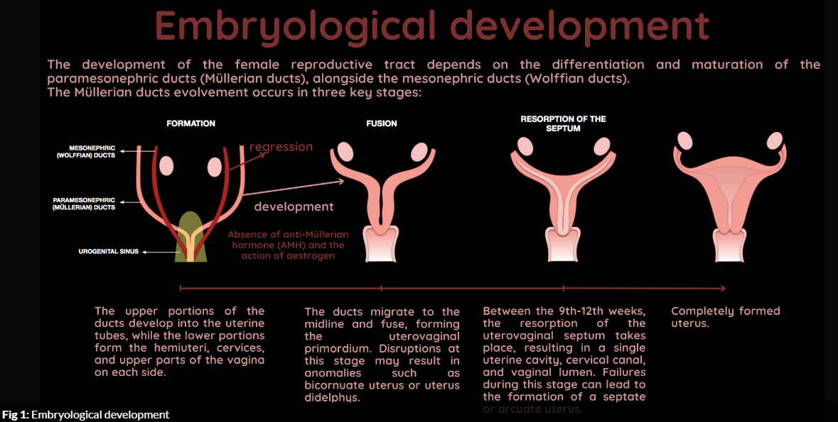

Slide 8
development of the Müllerian ducts
completion of three phases:
■ Organogenesis (Duct development)
■ Fusion (Duct fusion )
■ Septal resorption
The etiology behind this failure is unknown and no genetic linkages identified

Slide 9
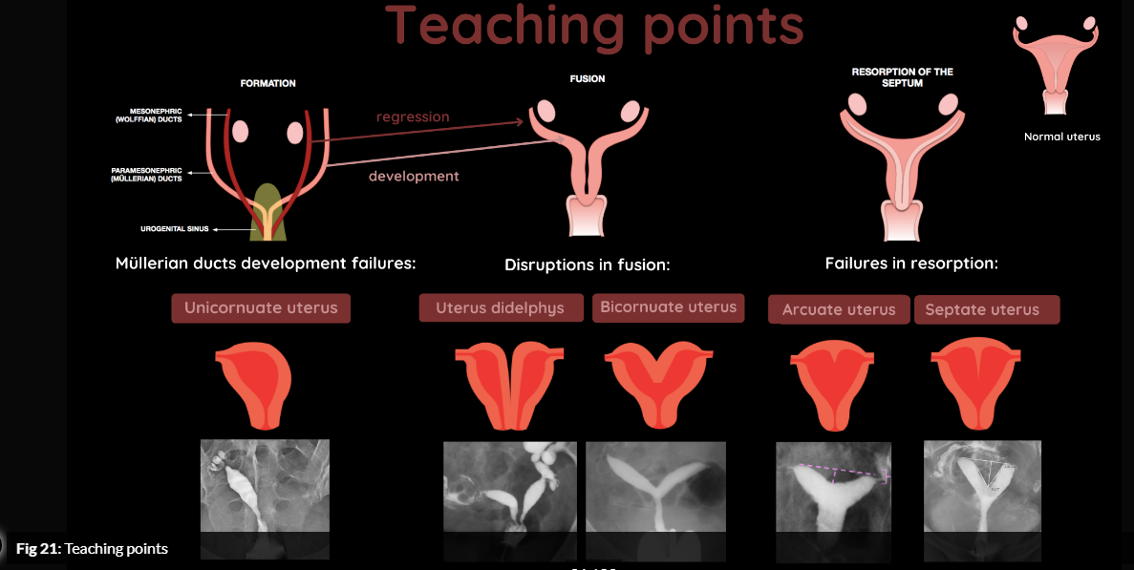

Slide 10
Organogenesis Failure (Duct development)
agenesis or hypoplasia of the
uterus
fallopian tubes
Cervix
upper vagin
unicornuate uterus

Slide 11
Duct fusion
Mullerian ducts fuse from the caudal to the cranial end
forming the uterus, cervix, and upper two-thirds of the vagina (Mullerian vagina)
The lower one-third of the vagina is derived from the urogenital septum
The unfused cranial portion of ducts form fallopian tubes.

Slide 12
Fusion Failure
uterus didelphys (complete failure)
bicornuate (incomplete failure)

Slide 13
Septal reabsorption
between 9 - 12 weeks of gestation

Slide 14
Septal resorption defects
Septate
Arcuate uterus
In the vagina, failure of resorption of Mullerian ducts results longitudinal vaginal septum (LVS)
failure of vaginal plate canalization results transverse vaginal septum.

Slide 15
Classification of Congenital Uterine Anomalies

Slide 16
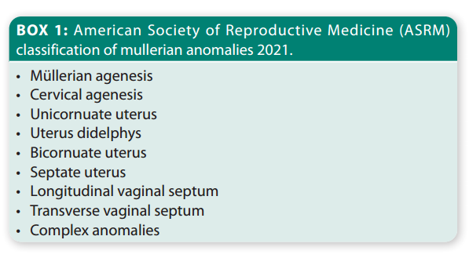
American Society of Reproductive Medicine Müllerian Anomalies Classification 2021 (also referred to as MAC 2021)

Slide 17
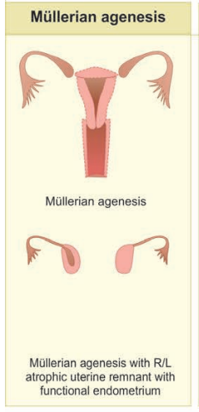
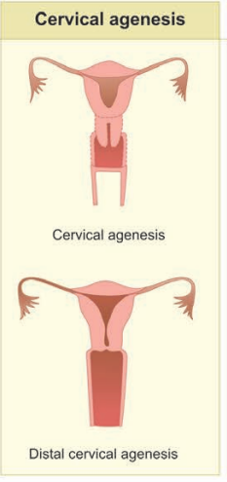
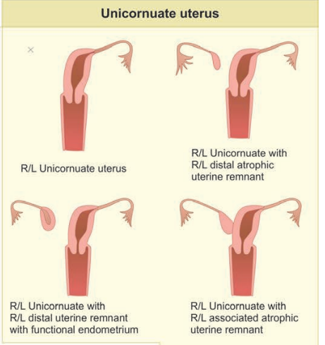
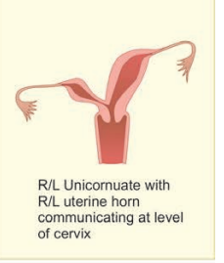
ASRM classification of Müllerian anomalies

Slide 18
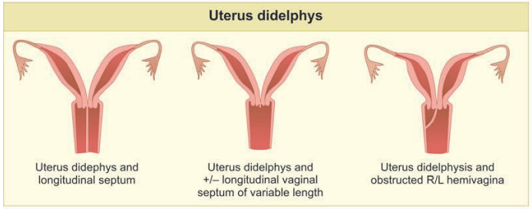
ASRM classification of Müllerian anomalies

Slide 19
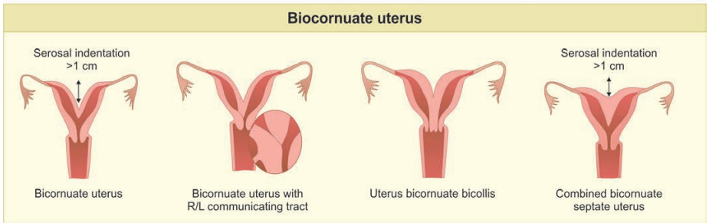
ASRM classification of Müllerian anomalies

Slide 20
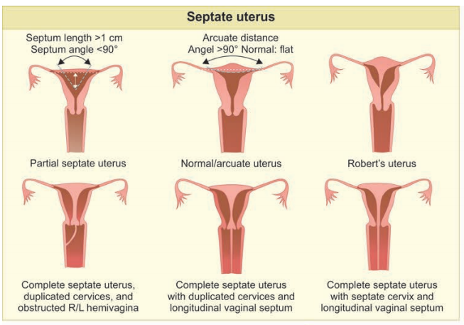
ASRM classification of Müllerian anomalies

Slide 21
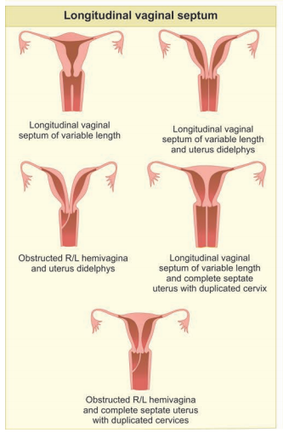
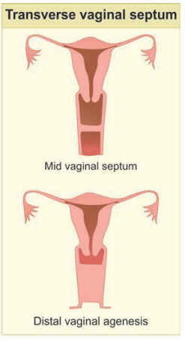
ASRM classification of Müllerian anomalies

Slide 22
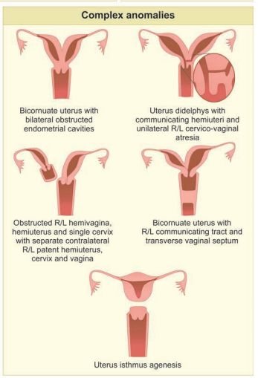
ASRM classification of Müllerian anomalies

Slide 23
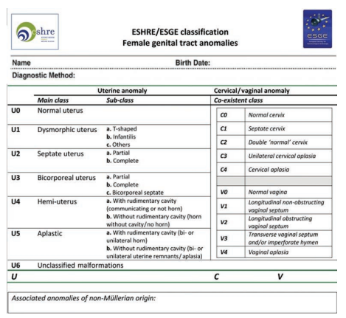
classification of Müllerian anomalies ESHRE/ESGE 2013 edition

Slide 24
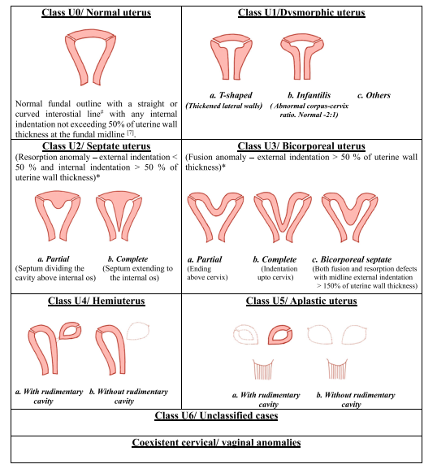

Slide 25
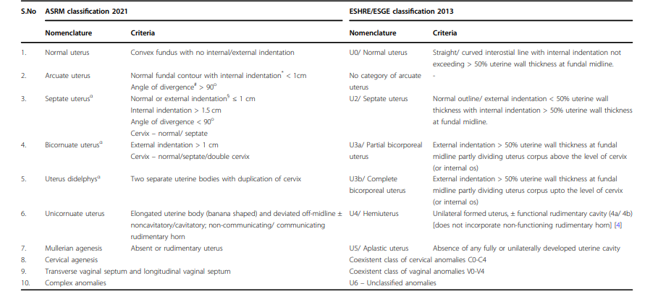
Comparison of ASRM 2021 and ESHRE/ESGE 2013 classification systems

Slide 26
Clinical Presentation and Diagnostic Modalities
Asymptomatic
cyclic or noncyclic pelvic pain and dysmenorrhea an obstructive anomaly (retrograde menstruation, and endometriosis)
Primary amenorrhea Müllerian agenesis or Mayer– Rokitansky–Küster–Hauser (MRKH) syndrome congenital absence of the uterus and vagina (ASRM­Müllerian agenesis, CONUTA­U5b).
septate uterus and uterus didelphys abnormal uterine bleeding (AUB)
Endometriosis are more common in patients with congenital anomalies
probably due to obstruction and retrograde menstruation which may also lead to infertility

Slide 27
Imaging modalities
Hysterosalpingography (HSG)
initial tool for evaluation of tubal patency in infertility.
The role of evaluation of MDAs is limited
because it does not provide any information about the external contour of the uterus or the uterine cavity not communicating with the cervix.
It cannot be performed in agenesis or dysgenesis of the cervix

Slide 28
Imaging modalities
Ultrasound (USG)
2D USG has limitations in terms of inadequate visualization of uterine contour, inter-operator variability, and low sensitivity.
3D transvaginal USG (3D TVS) better assessment of external fundal contour and internal indentation of the endometrial cavity.
Thick and echogenic endometrium in the secretory phase helps in better evaluation of MDAs,
thus pelvic USG for their evaluation should be scheduled in the latter part of the menstrual cycle.
Ovaries should be identified in all patients and malpositioned ovaries should be looked for, which would require a transabdominal scan at times.

Slide 29
Imaging modalities
Three-­dimensional sonography has become the gold standard tool for the diagnosis of CUAs.

Slide 30
Imaging modalities
Magnetic resonance imaging (MRI)
the ideal imaging modality
it gives exquisite information both external contour and internal anatomy.
T2WI helps in the accurate delineation of uterine zonal anatomy and the presence of functional endometrium and helps in the precise classification of anomalies .
It also provides information regarding ovaries and adnexa.
T1WI allows the identification of glands in endometriosis or blood products in hematometrocolpos .
Associated ovarian maldescent (high-placed ovaries at or above the level of internal iliac artery bifurcation) and renal anomalies can also be simultaneously identified.
the use of 3D TVS is not possible in patients who are not sexually active or with vaginal agenesis, obstruction, and complex anomalies so MRI is best in these patients

Slide 31
MR imaging protocol
irrespective of the patient’s menstrual cycle.
recommend fasting for 3–6 h, however, no consensus exists.
Emptying the bladder 1 h prior to the examination is recommended
antiperistaltic agents (20 mg of butylscopolamine or 1 mg glucagon IM/IV) are administered to reduce bowel motion artifacts and thus obtain highquality MR imaging.
Aqueous vaginal gel (~60 mL) can be administered in a small percentage of patients when required.

Slide 32
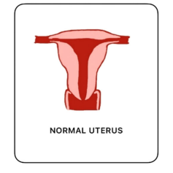
Normal uterus
pear-shaped
convex or straight external fundal contour with no internal indentation

Slide 33
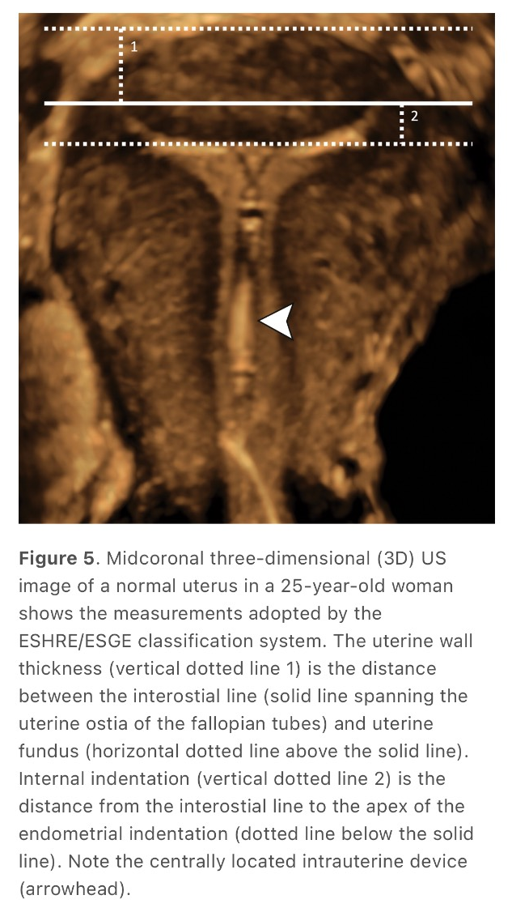
Normal uterus

Slide 34
Mullerian agenesis
agenesis of fallopian tubes, uterus, cervix, and proximal two-thirds of the vagina in variable degrees
This occurs as a part of Mayer–Rokitansky–Kuster–Hauser (MRKH) syndrome with a prevalence of 1 in 4500 women.
It is characterized by Mullerian agenesis, normal development of secondary sexual characteristics, and a normal 46XX karyotype.
MRKH is of two types:
type I or isolated uterovaginal aplasia
type II MRKH incomplete aplasia and/or associated renal (40%), cardiac, skeletal (30–40%) abnormalities and hearing defects (10–25%)

Slide 35
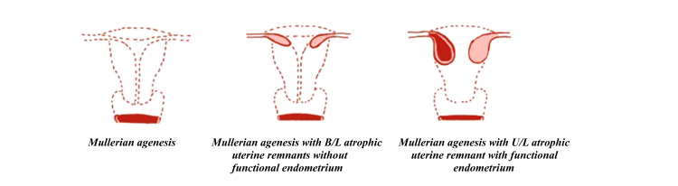
Imaging
HSG cannot be performed in Mullerian agenesis and thus has no role in diagnosis.
USG is the initial imaging modality, and findings include the absence of a uterus and identification of uterine remnants, if present, may be challenging. Normal-appearing ovaries are seen in either a normal or abnormal location.

Slide 36
MRI
Sagittal T2W MR useful as the expected location of the uterus , location of the bladder, urethra, and lower vagina
complete absence of uterine tissue
more often, a small hypoplastic uterus
Prepubertal females show no zonal anatomy
after puberty, poorly defined zonal anatomy may be seen under the influence of female hormones.

Slide 37
Normally, the vagina appears as a T2 hypointense structure between the urethra, neck of urinary bladder anteriorly, and rectum posteriorly
Sagittal T2WI is useful to measure the maximum vaginal length and thus aid in vaginal dilatation and surgical procedures

Slide 38
Clinical importance and management
primary amenorrhea and pelvic pain in the presence of functional endometrium in the uterine remnants.
Pain cyclical due to functional endometrium or chronic due to retrograde menstruation causing endometriosis.
Imaging, especially MRI, can help in primary amenorrhea and with normal secondary sexual characteristics
Treatment of Mullerian agenesis includes vaginal dilatation and the creation of a neovagina by surgical procedures to enable normal sexual function.

Slide 39
Management
Serial Frank’s dilators
modified Abbè– McIndoe operation is the most common surgical procedure used to create a neovagina
The laparoscopic Vecchietti procedure is a modification of the open technique

Slide 40
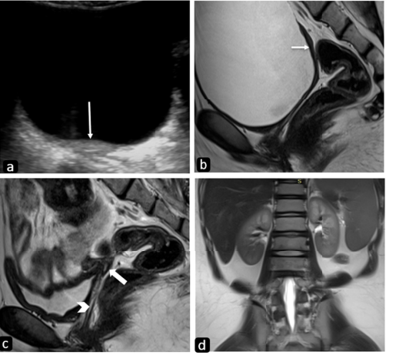
MRKH syndrome type 1: (a) USG pelvis of a seventeen-year-old girl 46XX karyotype in the transverse plane reveals an ovoid hypoechoic structure posterior to the urinary bladder with poor zonal anatomy (arrow) suggesting the possibility of a hypoplastic uterus. Sagittal T2W MR image (b) reveals a small hypointense linear structure posterior to the bladder in the expected location of the uterus (arrow). The sagittal image obtained after partially emptying the bladder (c) better depicts the rudimentary zonal anatomy confirming the presence of a hypoplastic uterus (thick arrow). Also, note the vagina seen as a linear hyperintensity between the bladder and rectum (thin arrow). T2W coronal image (d) of the upper abdomen reveals both kidneys to be normal

Slide 41
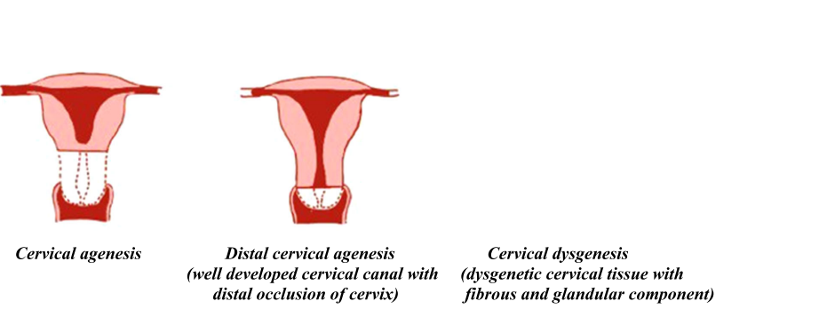
Cervical agenesis
part of Mullerian agenesis
Isolated cervical agenesis is extremely rare
results from interrupted development of Mullerian ducts with no communication between the uterus and vagina

Slide 42
Imaging
USG : a lack of a well-defined cervical canal with an obstructed and distended endometrial cavity, fallopian tubes with blood contents, and endometriosis.
MRI the most useful imaging modality.
On T1WI, or On T2WI
In cervical agenesis, no cervical tissue or dysgenetic cervix is visualized between the uterus and vagina.
Additional findings of retrograde menstruation such as hematometra, hematosalpinx, or endometrioma are seen in the form of distended fluidfilled uterine cavities and fallopian tubes which appear hyperintense on T1WI and heterogeneous on T2WI

Slide 43
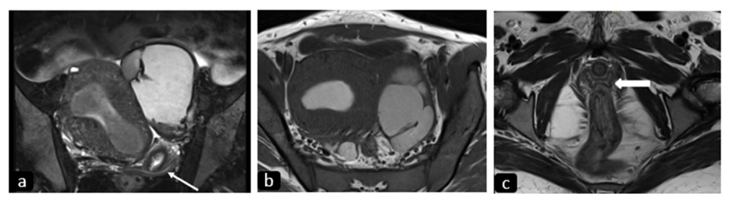
Isthmic agenesis: T2W coronal (a) and T1W axial (b) images of a nineteen-year-old girl with primary amenorrhea (a) reveal a normal-sized uterus with the endometrial cavity distended by T2 hypointense and T1 hyperintense contents suggesting blood products. Note the cervix (thin arrow) in a with no communication between the uterus and cervical canal. The uterus is pushed to the right by a hemorrhagic left tubo-ovarian mass due to retrograde menstruation. The normal H-shaped vagina (thick arrow) is well seen on a more inferior T2W axial image (c)

Slide 44
Clinical importance and management
similar to other obstructive Mullerian anomalies
primary amenorrhea
pelvic pain due to hematometra, hematosalpinx, and endometriosis.
Treatment options include medical and surgical procedures such as cervicoplasty and uterovaginal anastomosis.
In case of failure of these procedures, a hysterectomy of the obstructed uterus may be required .

Slide 45
Unicornuate uterus
Unicornuate uterus is formed due to the normal development of one Mullerian duct and failed or arrested development or failure of migration of the other.
prevalence is 0.3%
The uterine remnants can be atrophic without endometrium or
functional with endometrium (cavitatory)
Up to 90% of cases are associated with a rudimentary uterine horn, and 25% of these cases will be associated with a functional noncommunicating uterine horn
most common associated with renal anomalies (40%)
renal agenesis most frequent and ipsilateral to the rudimentary horn

Slide 46
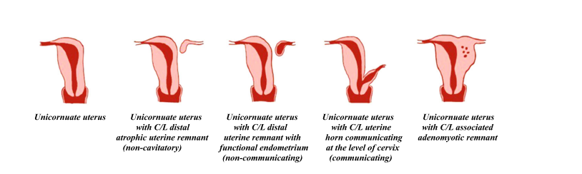
Diagrammatic representation of variants of unicornuate uterus

Slide 47
Imaging
HSG limited role in the diagnosis of the contralateral uterine remnant
it can only detect the cavitatory, communicating uterine remnant.
a bicornuate bicollis uterus and uterus didelphys similar appearance when only one of the cervical canals is cannulated.
USG: it is seen as a small, oblong-shaped, off-midline structure with endometrium
Rudimentary horn may missed or misdiagnosed as pelvic mass or cervix .

Slide 48
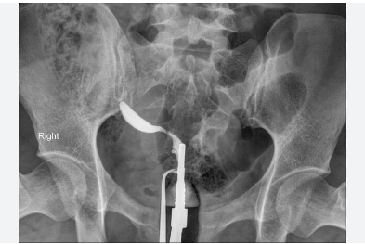
HSG

Slide 49
MRI, the unicornuate uterus is seen as a small, curved banana-shaped uterus with normal width of endometrium and myometrium
The contralateral uterine remnant and its communication with the unicornuate uterus is also well-visualized.
Detection of endometrium within the uterine remnant is important as the clinical presentation depends on the same.
The cavitatory, noncommunicating type manifests with blood products distending the endometrial cavity and findings of endometriosis

Slide 50
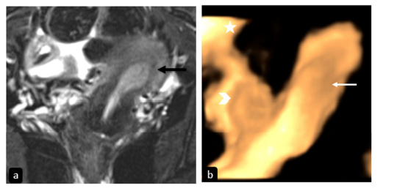
Unicornuate uterus. T2-FS coronal MR image (a) in a 31-year-old female with primary infertility reveals an off-midline left-sided banana-shaped uterine horn (black arrow) continuous with the cervix inferiorly s/o left-sided unicornuate uterus. 3D transvaginal USG image (b) in another patient shows a leftsided unicornuate uterus (white arrow) with a small non-cavitary non-communicating rudimentary horn on the right side (arrowhead). The right ovary is normal (asterisk)

Slide 51
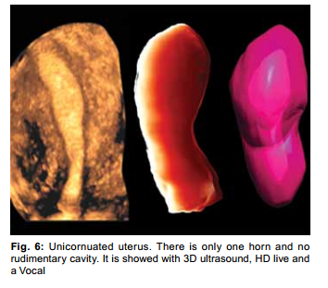
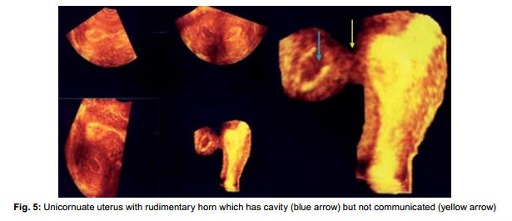

Slide 52
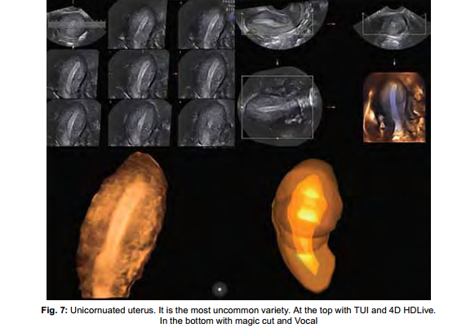

Slide 53
A unicornuate uterus with a cavitatory communicating remnant can be distinguished from a bicornuate uterus :
asymmetry of two uterine cavities in the former, which is extremely rare in the latter.

Slide 54
Clinical importance and management
The age and symptoms depend on status of rudimentary horn.
The cavitatory, communicating rudimentary horn presents with malpresentation, preterm labor, or pregnancy loss.
The cavitatory, noncommunicating rudimentary horn presents with lateralized cyclical pelvic pain
Simple and atrophic uterine remnant usually detected incidentally
Treatment options include resection or reunification of the uterine remnant with unicornuate uterus.

Slide 55
Surgical excision of the rudimentary horn(laparotomy-laparoscopic removal)
By sperm migration through the peritoneal cavity, pregnancy in the rudimentary horn is possible
prophylactic excision of the cavitated horn is still a subject of open debate

Slide 56
Uterus didelphys
fusion anomaly : complete or incomplete arrest of fusion of Mullerian ducts
duplication of uterine horns and cervix
May be Duplication proximal vagina
0.1–0.5% of women, comprising ~11% of uterine malformations
Duplicated or double vagina is the result of LVS, either complete (75%) or partial.
Renal agenesis in 20% of cases
uterine didelphys with obstructed hemivagina with ipsilateral renal agenesis (OHVIRA) being the most common association

Slide 57
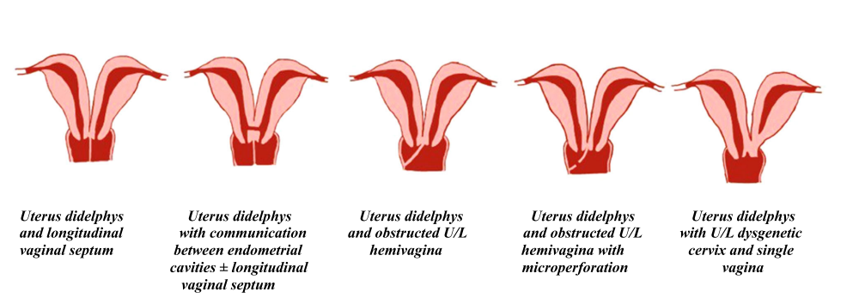
Diagrammatic representation of variants of uterus didelphys

Slide 58
Imaging
HSG
two separate cavities, cervical canals, often a double vagina
If obstructed hemivagina, misdiagnosed as a unicornuate uterus.
two symmetrical widely divergent, noncommunicating endometrial cavities and two cervical canals and a double upper vagina

Slide 59
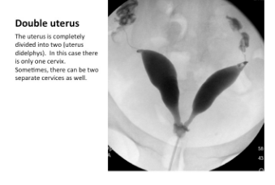
HSG

Slide 60
MRI
two separate divergent uterine cavities of normal volume with normal zonal anatomy.
The double cervix as two separate cervical canals with a mean intercervical distance of approximately 12.05 mm ,significantly higher than that of the septate cervix in bicornuate and septate uteri
In obstructed hemivagina with hematometrocolpos, T1 hyperintense blood products are seen within

Slide 61
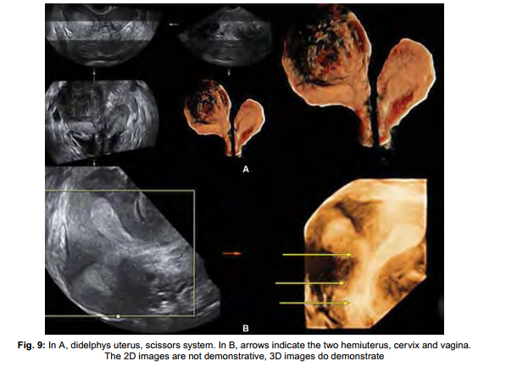

Slide 62
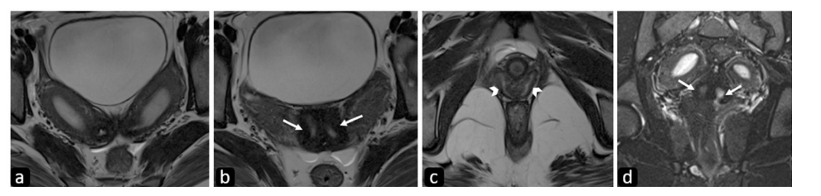
Uterus didelphys with double cervix and vaginal septum. Axial T2-weighted (a–c), and T2-FS coronal (d) MR images in a twenty-year-old female patient demonstrate two widely divergent uterine cavities showing normal zonal anatomy with no communication between them (a). Two cervical canals (arrows in b, d) are seen separated by an intervening myometrium suggesting a double cervix giving an owl’s eye appearance with increased intercervical distance. Two vaginal canals (arrowheads) are better appreciated in (c)

Slide 63
Clinical importance and management
hemivaginal with obstruction present with dysmenorrhea (endometriosis)
pelvic infections
Adhesions
without obstruction are usually asymptomatic.
Treatment includes resection of obstructing vaginal septum or removal of obstructed hemiuterus.

Slide 64
Bicornuate uterus
Impairment in the fusion of Mullerian ducts
heart-shaped uterus
It is seen in 0.1–0.6% of women
The cervix can be single (unicollis), septate/double (bicollis),unilateral cervical atresia
Vagina may :
single
longitudinal septum
transverse vaginal septum either obstructing or with microperforation.

Slide 65
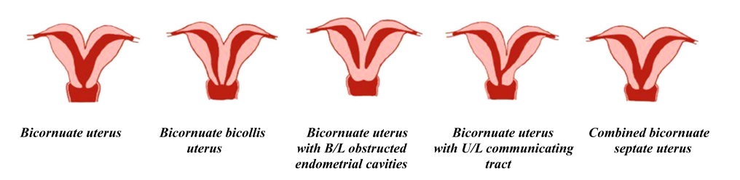
Diagrammatic representation and imaging features of bicornuate uterus. Diagrammatic representation of variants of bicornuate uterus.

Slide 66
Imaging
HSG
differentiation of the bicornuate uterus from the septate uterus is difficult
the bicornuate uterus demonstrates two separate uterine cavities with an intercornual angle of > 105 degrees
septate uterus with an intercornual angle < 75 degrees

Slide 67
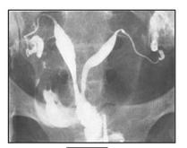
HSG

Slide 68
USG
2D USG : not reliable as the external fundal contour cannot be assessed.
3D USG: deep fundal cleft >1 cm (ASRM) and diverging endometrial cavities are seen

Slide 69
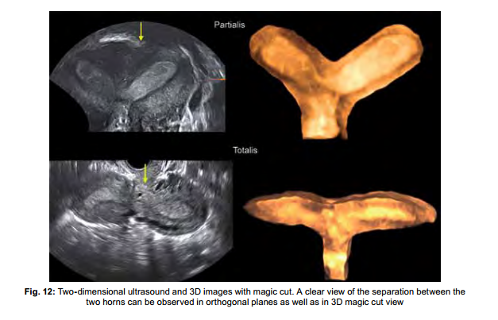

Slide 70
MRI
a deep fundal cleft
two uterine cavities with normal zonal anatomy
an intercornual distance >4 cm.
In bicornuate unicollis, a single cervical canal
in bicornuate bicollis, two T2 hyperintense cervical canals (duplicated cervix) the “owl eye” appearance
The intracervical distance in bicornuate uterus is ~5.4 mm, less than that in uterus didelphys
The vagina may show a LVS (in one-fourth of cases) which, if present, makes bicornuate bicollis virtually indistinguishable from uterus didelphys

Slide 71
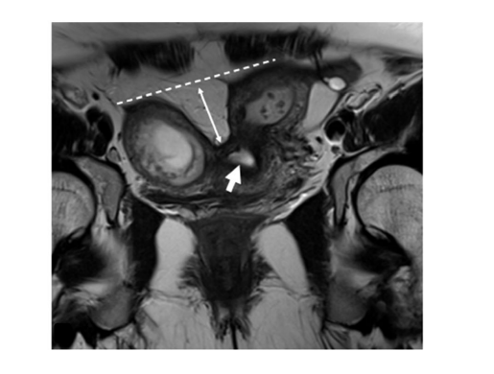
Bicornuate uterus with single cervix. T2 weighted coronal MR image demonstrates two widely separate endometrial cavities with external indentation greater than 1.5 cm (double-edged arrow) with a single cervix (thick arrow)

Slide 72
Clinical importance and management
menstrual symptoms such as dyspareunia
lateralized cyclical pain
menstrual leakage even with tampon use
pregnancy concerns such as preterm labor, malpresentation, pregnancy loss, and post-partum hemorrhage.
Surgical management includes reunification by metroplasty (Strassman/Jones/ Tompkins).
The necessity of surgical repair of this specific anomaly is currently highly debatable and generally not indicated .
Because it is too traumatic for the uterus, and there are serious concerns about future fecundity and uterine integrity in a subsequent pregnancy

Slide 73
Counseling pregnant women with bicornuate uterus, either surgically repaired or not, about the necessity of a cesarean section is crucial because the risk of uterine rupture is increased .
Cervical cerclage might be considered because cervical incompetence is anissue in patients with bicorporeal uterus .

Slide 74
Septate uterus
Failure of resorption of uterovaginal septum :septate and arcuate uterus
Septate uterus is the most common Mullerian anomaly~55% of MDA
prevalence of 2.3%
Septae partial or complete whether is reaching the internal os or not
The cervix may be single, septate, or duplicate
vagina may show a non-obstructing septum or obstructed hemivagina (OHVIRA)

Slide 75
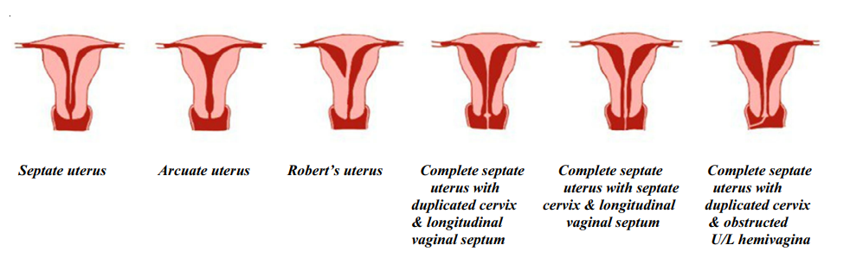
Diagrammatic representation of variants of septate uterus.

Slide 76
Imaging
HSG can evaluate the internal contour only.
intercornual angle < 75° septate uterus rather than a bicornuate uterus
the external uterine contour cannot be demonstrated and thus is not reliable

Slide 77
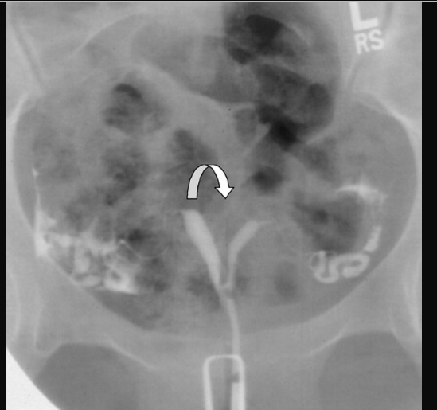
HSG

Slide 78
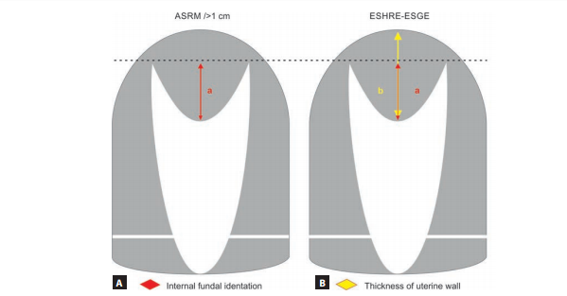
A) American Society for Reproductive Medicine (ASRM) recommended considering a uterus as septate when there is both an indentation depth >10 mm and an indentation angle <90°, while a normal/arcuate uterus should have both an indentation depth <10 mm and an indentation angle >90°, and a uterus that does not fit these criteria would be left in an unclassifiable ‘gray-zone’; (B) European Society for Gynecological Endoscopy (ESGE) recommended using an indentation-to-wall-thickness (I:WT) ratio >50% to diagnose septate uterus.
Over diagnosis of uterine septum (50% of the septum is 4–5 mm if the myometrial wall thickness for example is 8 mm so if you measure the internal fundal indentaion more than 4 mm it will be considered as septum by the ESHRE/ESGE classfication.
(ASRM: American Society of Reproductive Medicine; ESHRE-ESGE: European Society of Human Reproduction and Endocrinology-European
Society of Gynecological Endoscopy)

Slide 79
USG
2D transvaginal ultrasound specially in the transverse plane with movement up and down from the fundus to the cervix can be used but not a diagnostic tool.
3DUS is more sensitive and specific than MRI

Slide 80
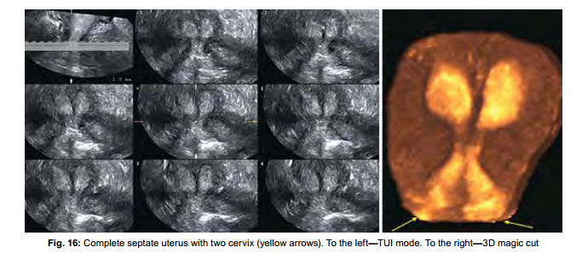
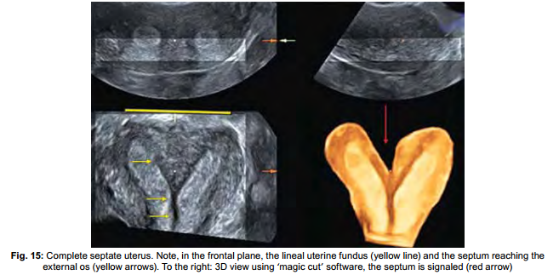

Slide 81
MRI
a convex or straight external fundal contour with an intervening septum is seen.
The septum may be fibrous (low T2 signal intensity) or muscular (intermediate signal intensity)
separating the endometrial cavities that reduced in volume and show normal intercornual distance (2–4 cm)
normal endometrial to myometrial width and ratio, but internal indentation > 1.5 cm (ASRM) suggests septate uterus.

Slide 82
MRI
internal indentation ≥ 1 cm to ≤ 1.5 cm is considered a “gray zone” according to ASRM criteria
partial (not reaching up to the internal os)
complete (reaching up to the internal os)
also extend into the cervix or vagina.
In a complete septate uterus with a septate cervix, the intercervical distance is approximately 5.43 mm
Rarely, true cervical duplication can also be seen.

Slide 83
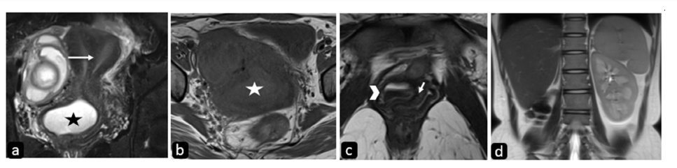
Complete septate uterus with obstructed hemivagina and ipsilateral renal agenesis. T2 weighted coronal and T1 weighted axial MR images (a, b) in a twenty-one-year-old female patient demonstrate two endometrial cavities separated by a septum (arrow) extending into the cervix and vagina, the right hemivagina is distended with T2 hyperintense (black asterisk in a) and mild T1 hyperintense contents (white asterisk in b) suggesting blood products. To advantage, T2 weighted axial MR image (c) depicts the two vaginal canals separated by a longitudinal septum (short arrow) with layering of blood products as dependent hypointense and upper hyperintense contents (arrowhead) in distended right hemivagina. T2 weighted coronal MR image of the upper abdomen (d) reveals the absence of the right kidney

Slide 84
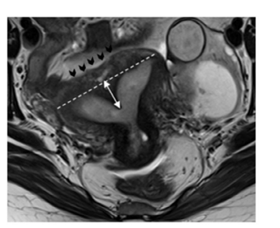
Partial septate uterus. Axial T2 weighted MR image of a twenty-six-old year female patient with recurrent first-trimester pregnancy loss demonstrates a straight external fundal contour (black arrowheads) with internal indentation greater than 1.5 cm (double-headed arrow) from the interostial line (dashed line). The upper part of the septum is isointense to the adjacent myometrium suggesting the muscular septum does not reach up to the internal os. Note made of a tubo-ovarian hemorrhagic mass in the left adnexa

Slide 85
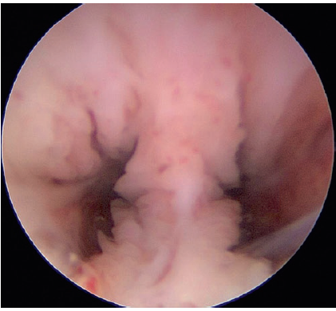
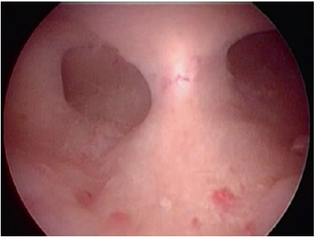
Hystroscopy
Complete uterine septum.
Partial uterine septum

Slide 86
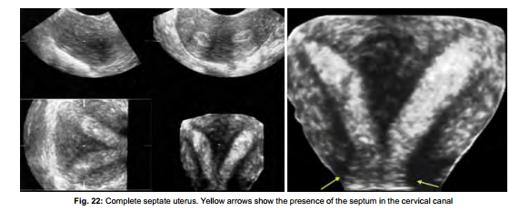

Slide 87
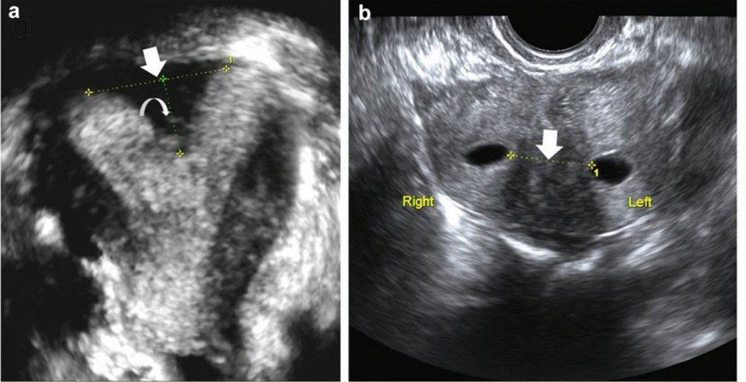
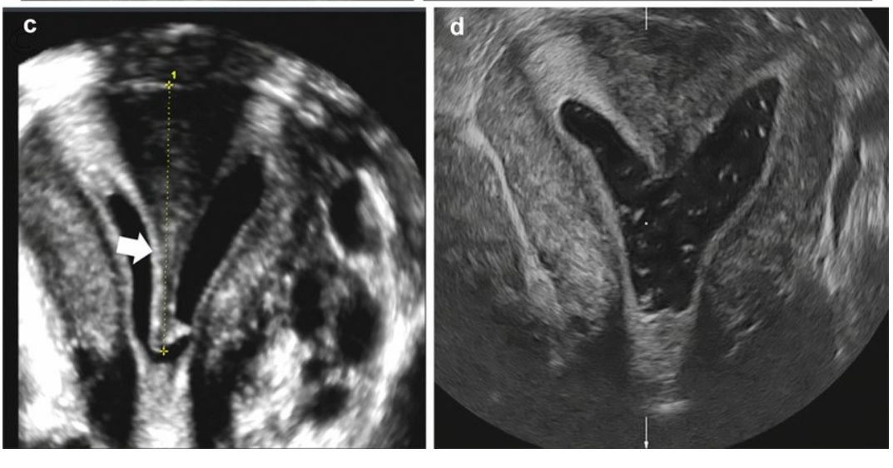
25-year-old female with septate uterus: a Sagittal, transvaginal sonogram showing measurement of the myometrial septum (curved arrow) and inter-cornual distance (arrow) in septate uterus. b SIS was performed for better evaluation. Axial SIS image shows the exact thickness of myometrial septum (arrow). c Coronal SIS image shows the exact length of the myometrial septum measured from the level of uterine fundus (calipers and arrow). d SIS imaging performed in same patient demonstrates adequate resection of the septum

Slide 88
Clinical importance and management
The clinical presentation depends on the type of septum
muscular septum is more vascular and predominantly presents with changes in uterine motility resulting in preterm delivery or miscarriage.
The fibrous septum is less vascular and interferes with implantation
It should be distinguished from Ashermann syndrome where multiple T2 hypointense intrauterine synechiae are seen.

Slide 89
Clinical importance
high rates of both first and second-trimester abortions
preterm deliveries
fetal malpresentation.
no definite direct relationship between the septate uterus and infertility

Slide 90
Management
Incidentally diagnosed: treatment for incidentally diagnosed septum in infertile women is debatable and unproven
Septum resection is a feasible procedure and can be easily performed by hysteroscopy. During the procedure, the tubal ostia are the surgical landmarks for proper orientation

Slide 91
Management
Hysteroscopic incision or resection of fibrous septum
transabdominal approach for muscular septum.
The absence of a separate class for arcuate uterus in the ESHRE/ESGE classification system
misdiagnosis as a septate uterus which renders the patient eligible for septal resection.

Slide 92
Another important the septate uterus must be distinguished from the bicornuate uterus
the treatment of these differs greatly
laparoscopic metroplasty
septoplasty
MRI is an excellent tool to differentiate

Slide 93
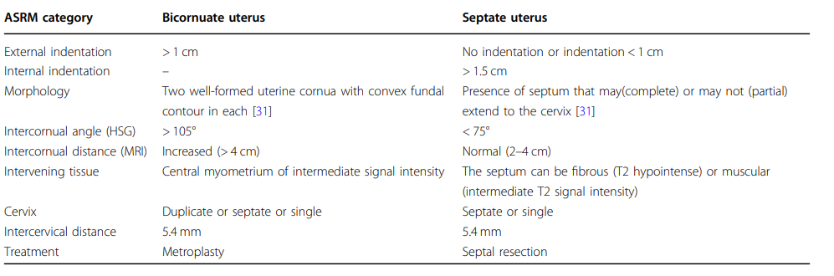
Differentiating features between bicornuate and septate uterus

Slide 94


Slide 95


Slide 96
Evidence-based diagnosis and treatment for uterine septum: a guideline
recommended to use 3D transvaginal ultrasound with or without saline infusion as the first-line noninvasive diagnostic tool in uterine shape assessment.
No recommendation can be made regarding the association between a septate uterus and infertility due to insufficient evidence.
recommended to counsel patients that the presence of a septate uterus is associated with spontaneous abortion and obstetric complications
septum incision in patients with infertility and/or undergoing fertility treatment is reasonable, a firm recommendation for this practice cannot be made on the basis of the current evidence.
recommended to counsel patients with infertility and/or undergoing fertility treatment that resection of septum may or may not be associated with an increase in live births.

Slide 97
Evidence-based diagnosis and treatment for uterine septum: a guideline
recommended to offer hysteroscopic septum incision to patients with a septum and a history of recurrent miscarriage in a shared decision-making model
recommended to counsel patients that septum incision may decrease the risk of adverse obstetric outcomes such as malpresentation and cesarean section, but there are no high-quality data to recommend this practice.
not recommended to use septum characteristics such as size or shape to determine the impact on adverse reproductive outcomes.
recommended, on the basis of expert committee opinion, to consider performing the procedure during the follicular phase or after progesterone withdrawal to help with visualization during surgery. However, there are no studies designed to prove or disprove this

Slide 98
Evidence-based diagnosis and treatment for uterine septum: a guideline
recommended to counsel patients that, there is no evidence that resection of the unicollis cervical septum increases the risk of cervical insufficiency.
not recommended to perform another surgery for a residual septum under 1 cm.
insufficient evidence to recommend routine administration of oral estrogen, intrauterine balloons, and IUDs to decrease adhesion formation after resection of a septum.
It appears the rate of uterine rupture after resection of a septum is rare.
recommended to counsel patients that they may proceed with fertility treatment in 12 months after resection of a septum.
insufficient evidence to recommend hysteroscopic resection of a septum in patients who have not yet attempted conception

Slide 99
Arcuate uterus
no significant effect on pregnancy outcomes.
Internal indentation < 1 cm (ASRM)
angle of leading edge > 90°
The indentation in the arcuate uterus is broad and saddle shaped
No fibrous tissue or septum is in the arcuate uterus

Slide 100

Arcuate uterus

Slide 101


Slide 102

Congenital Uterine Malformation by Experts (CUME): Better criteria for distinguishing between normal/arcuate and septate uterus? The criteria are: (A) I:WT ratio >110%; (B) indentation angle <140°; (C) indentation depth ≥10 mm.
They suggest using internal indentation depth ≥10 mm to distinguish between a normal/arcuate and a septate uterus, because it is the simplest and most reliable measurement of these three.

Slide 103

HSG

Slide 104

Arcuate uterus: axial T2W MR image (a) of an arcuate uterus in a 26-year-old female patient with recurrent pregnancy loss shows a normal external fundal outline (white arrowheads) with an internal indentation lesser than 1.5 cm (doubleheaded arrow) from the interostial line. Note normal ovaries bilaterally (arrows). b 3D transvaginal USG image shows a broad saddle-shaped indentation of the arcuate uterus

Slide 105


Coronal image of an arcuate uterus. A reconstructed coronal image of the uterus in a 34-year-old woman obtained during threedimensional sonohysterography shows the arcuate configuration of the fundal part of the endometrial cavity.

Slide 106
Clinical importance and management
Evidence is controversial
slight association with:miscarriage
preterm birth
Large studies show no strong independent effect on fertility or live birth rate
No standard treatment recommended for isolated arcuate uterus
Hysteroscopic metroplasty:considered only in selected cases
benefit remains uncertain
Most guidelines: conservative management
Routine surgical treatment is not recommended

Slide 107

Dysmorphic (T-shaped) uterus
Dysmorphic T-shaped uterus is characterized by a narrow cavity due to the thickened lateral uterine walls
secondary to diethylstilbestrol (DES) exposure in utero.

Slide 108
Diagnose
absence of clear criteria to diagnose T-shaped uterus.
The ESHRE/ESGE classification mentioned dysmorphic uterus (T­shaped) with narrow cavity and thick lateral wall but there is no measurement for diagnosis.
The ASRM 2021 classification did not mention the criteria for
diagnosis of T-­shaped uterus.
The CUME has tried to solve this problem.

Slide 109
CUME criteria
measurable criteria for the classification of T­shaped uterus.
1. Lateral indentation depth ≥7 mm
2. Lateral indentation angle ≤130°
3. T­-angle ≤40°
If the three criteria are present, the case is T-­shaped uterus.
If two criteria are met, the case is borderline T-­shaped uterus.
In case one or no criteria is met, then it is a normal uterus.
This classification should be applied only when there is no internal fundal indentation ≥10 mm.

Slide 110

CUME criteria

Slide 111

T-shape uterus

Slide 112


Slide 113
Clinical importance and management
relation to RPL, infertility, and in vitro fertilization (IVF) failure
hysteroscopic metroplasty, incision on lateral uterine walls to expand the uterine cavity
diagnosis, prevalence, and clinical relevance on reproductive outcomes in women with T-shaped uterus is unknown.
Expectant management must be considered the most appropriate choice for daily practice until randomized controlled trials shows otherwise.

Slide 114
Developmental vaginal anomalies
Transverse vaginal septum
Incomplete vertical fusion between the vaginal components of the Mullerian tubercle and urogenital sinus
rare anomalies
1 in 30,000–84,000 women
The septum can be low (15%)/mid (40%)/high (45%) ± microperforation
It should be differentiated from imperforate hymen and cervical dysgenesis as they also present with primary amenorrhea and hydrometrocolpos.

Slide 115
USG and MRI
obstructing septum and resultant hydrometrocolpos.

Slide 116



Slide 117
Clinical importance and management
Patients usually present with obstructive symptoms.
Septal resection is the treatment of choice.

Slide 118
Longitudinal vaginal septum (LVS)
Failure of lateral fusion of the uterovaginal septum
uterus didelphys is the most common anomaly associated
bicornuate bicollis
complete septate uterus.
in clinical practice, LVS is most commonly seen with septate uterus due to its high prevalence.
LVS can be complete or partial, central or eccentric, non-obstructing or obstructing ± microperforation

Slide 119
Imaging
USG: hypoechoic band of fibrous tissue of variable length is seen extending through the vagina
MRI : T2 hypointense band along the length of the vagina resulting in a double vagina.
The two vaginal cavities can be either symmetrical or asymmetrical.

Slide 120
Clinical importance and management
The clinical presentation depends on obstruction
Non-obstructing : asymptomatic
difficulty in tampon insertion, leakage even with tampon use, or laceration during intercourse.
obstructing types with hemivaginal obstruction
differentiated from imperforate hymen, vaginismus, and vaginal adhesions.
Indications for resection of the septum include dystocia and dyspareunia

Slide 121
Complex anomalies
A combination of features of more than one class results in complex anomalies.
It is important that radiologists are aware of the similarities and differences between ASRM and ESHRE/ESGE classification and their impact on clinical management

Slide 122
Reproductive Outcomes
Venetis et al.concluded that the presence of CUA is associated with a decreased, albeit not significantly so, probability of pregnancy achievement both in natural and ART cycles.
Women with a septated or bicornuate uterus had a higher probability of spontaneous miscarriage even in the first trimester,
whereas in women with arcuate, didelphys, and unicornuate uterus the effect on reproduction is small and not statistically significant.
Increased risk of preterm birth and second trimester losses, in all types of CUA.
The implantation failure, spontaneous abortion, and impaired obstetrical
outcome
due to impaired vascularization of the endometrium, abnormal uterine contractility, and decreased uterine volume.

Slide 123
Recent Studies on Müllerian Anomalies and Pregnancy Outcomes
Author (Year) | Country | Study Title | Study Design / Sample Size | Main Pregnancy Outcomes
Kim MA et al. (2021) | South Korea | Reproductive, Obstetric and Neonatal Outcomes in Women with Congenital Uterine Anomalies: A Systematic Review and Meta-Analysis | Systematic Review & Meta-analysis; 79 studies, >25,000 women | Septate uterus showed the strongest association with recurrent miscarriage. Unicornuate uterus had the highest risk of preterm birth, fetal growth restriction (FGR), and low birth weight. Bicornuate and didelphys uterus were strongly associated with malpresentation and cesarean delivery.
Kang J et al. (2024) | China | Impact of Congenital Uterine Anomalies on Reproductive Outcomes of IVF/ICSI-ET | Retrospective Cohort; 1,428 women with CUA vs 4,200 controls | Septate uterus was associated with lower implantation and live birth rates and higher miscarriage rates. Fusion defects (bicornuate/unicornuate) were associated with increased preterm delivery and obstetric complications.
Caballero Campo M et al. (2024) | Spain | Impact of Congenital Uterine Anomalies on Obstetric and Perinatal Outcomes: Systematic Review and Meta-analysis | Meta-analysis; ~32,000 pregnancies | Unicornuate uterus demonstrated the highest rates of PPROM, preterm birth, and FGR. Septate uterus had the highest rate of recurrent pregnancy loss. Malpresentation was particularly common in bicornuate and didelphys uterus.
Fedele F et al. (2024) | Italy | Assisted Reproductive Technology Outcomes in Women with Congenital Uterine Anomalies: A Systematic Review | Systematic Review; 38 studies, >10,000 ART cycles | Women with septate uterus had reduced clinical pregnancy and live birth rates after ART. Bicornuate and didelphys uterus showed acceptable conception rates but persistent obstetric complications including preterm birth and cesarean section.

Slide 124

Treatment of congenital malformations

Slide 125
Recent Studies on Treatment of Müllerian Anomalies
Author (Year) | Country | Study Title | Sample Size | Treatment Method | Main Results
Abuzeid O et al. (2024) | USA | Obstetric Outcomes of Singleton Birth After Hysteroscopic Septoplasty of Complete Uterine Septum | 112 patients | Hysteroscopic septoplasty for complete septate uterus | Favorable obstetric outcomes after septoplasty. No increase in cervical insufficiency or preterm birth after cervical septum incision.
Goidescu IG et al. (2024) | Romania | Is Hysteroscopic Metroplasty Advisable for U2bC2V1 Malformation? | 3 cases | Hysteroscopic metroplasty + vaginal septum resection | All patients conceived after surgery with improvement in fertility and reduction in dyspareunia/dysmenorrhea.
Xiong W et al. (2024) | China | Comparison of Clinical Outcomes and Second-Look Hysteroscopy of the Complete and Incomplete Septate Uterus After Hysteroscopic Septoplasty | 64 patients | Hysteroscopic septoplasty | Similar reproductive outcomes in complete and incomplete septate uterus after surgery; term delivery rates improved and postoperative adhesions remained low.

Slide 126
Surgical Management and Reproductive Outcomes in Müllerian Anomalies
Author (Year) | Country | Study Title | Anomaly Type | Sample Size | Surgical Treatment | Main Results
Zhang Y et al. (2024) | China | Pregnancy Outcomes After Surgical Management of Unicornuate Uterus with Rudimentary Horn | Unicornuate uterus with rudimentary horn | 58 patients | Laparoscopic rudimentary horn excision | Reduced risk of ectopic/rudimentary horn pregnancy and improved subsequent obstetric outcomes.
Fedele L et al. (2023) | Italy | Long-Term Reproductive Outcome After Vaginal Septum Resection in Uterus Didelphys | Uterus didelphys with obstructed hemivagina | 74 patients | Vaginal septum excision | Significant improvement in fertility and reduction in pelvic pain/endometriosis-related complications.
Ludwin A et al. (2023) | Poland | Reproductive Outcomes After Laparoscopic Strassman Metroplasty in Women with Bicornuate Uterus | Bicornuate uterus | 32 patients | Laparoscopic metroplasty | Reduction in recurrent pregnancy loss and improvement in fetal viability and term pregnancy rates.

Slide 127


